Slide 1
STATEMENTS
A statement is a command given to the computer that instructs the computer to take a specific action, such as display to the screen, or collect input.
A computer program is made up of a series of statements.
The statements of a C program control the flow of program execution.
It is also called as Control Statements.
CONDITIONAL STATEMENTS
Conditional statements cause variable flow of execution of the same program, each time the program is run, based on certain condition to be true or false.
UNCONDITIONAL STATEMENTS
UnConditional statements allows you to direct the program's flow to another part of your program without evaluating conditions.

Slide 2
STATEMENTS
CONDITIONAL STATEMENTS
SELECTION STATEMENTS( making decisions)
REPETITION STATEMENTS(loops)
UNCONDITIONAL STATEMENTS
OTHER STATEMENTS RELATED TO LOOPING (OR) JUMPING STATEMENTS

Slide 3
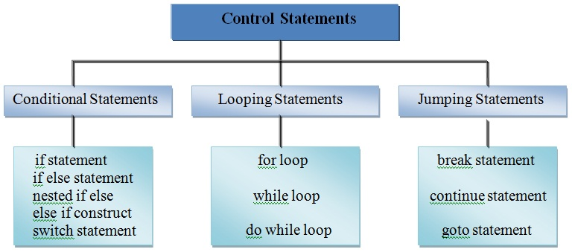

Slide 4
SELECTION STATEMENTS( making decisions)
Decision making statements are the statements that are used to verify a given condition and decides whether a block of statements gets executed or not based on the condition result.
In c programming language, there are two decision making statements they are as follows…
if statement
switch statement

Slide 5
Objectives of Today's Session
To understand how decisions are made in a computer
To write programs using logical and comparative operators
To write programs that use two-way selection: if ...else statements
To write programs that use multi-way selection: else...if statements

Slide 6
if STATEMENT
If statements in C is used to control the program flow based on some condition, it’s used to execute some statement code block if expression is evaluated to true, otherwise it will get skipped.
This is an simplest way to modify the control flow of the program.
The if statement in C can be used in various forms depending on the situation and complexity.
There are four different types of if statement in C. These are:
Simple if Statement
if-else Statement
Nested if-else Statement
else-if Ladder

Slide 7
Simple if Statement
Syntax:
if(test_expression) { statement 1; statement 2; ... }
‘statement n’ can be a statement or a set of statements and if the test expression is evaluated to true, the statement block will get executed or it will get skipped.

Slide 8
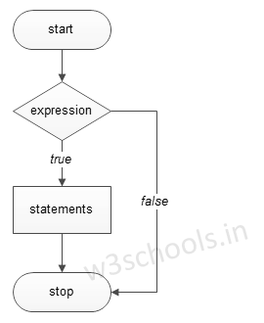
Flowchart of simple if Statement:

Slide 9
Example of a C Program to Demonstrate simple if Statement
Output:
a is less than 20; value of a is : 10
#include <stdio.h> int main ()
{ /* local variable definition */ int a = 10; /* check the boolean condition using if statement */ if( a < 20 )
{ /* if condition is true then print the following */ printf("a is less than 20\n" ); } printf("value of a is : %d\n", a); return 0; }

Slide 10
if - else statement
If –else statement takes care of true as well as false conditions.
‘Statement block-1’ is executed when the condition is true and ‘Statement block-2’ (or) ‘else block’ is executed when the condition is false.
Syntax:
if (condition)
{
Statement block-1;
}
else
{
Statement block-2;
}
Statement-x;

Slide 11
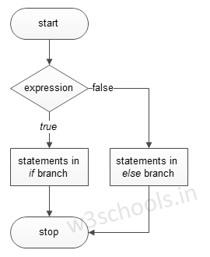
Flowchart of if else Statement

Slide 12
Example of a C Program to Demonstrate if else Statement
/* checking for even (or) odd number */
#include<stdio.h>
int main()
{
int n;
printf (“enter a number”);
scanf (“%d”, &n);
if (n%2 ==0)
{
printf (“%d is even number”, n);
}
else
{
printf( “%d is odd number”, n);
}
printf(“n=%d”,n);
return 0;
}
Output 1 :
enter a number 10
10 is even number
n=10
Output 2 :
enter a number 5
5 is odd number
n=5

Slide 13
Nested if else Statement
A ‘nested if’ is an if statement that is the object of either if (or) an else.
‘if’ is placed inside another if (or) else.

Slide 14
Syntax of Nested if else Statement
if (condition1)
{
if (condition2)
{
Statement block-1;
}
else
{
Statement block-2;
}
}
else
{
if (condition3)
{
Statement block-3;
}
else
{
Statement block-4;
}
}
Statement- N;

Slide 15
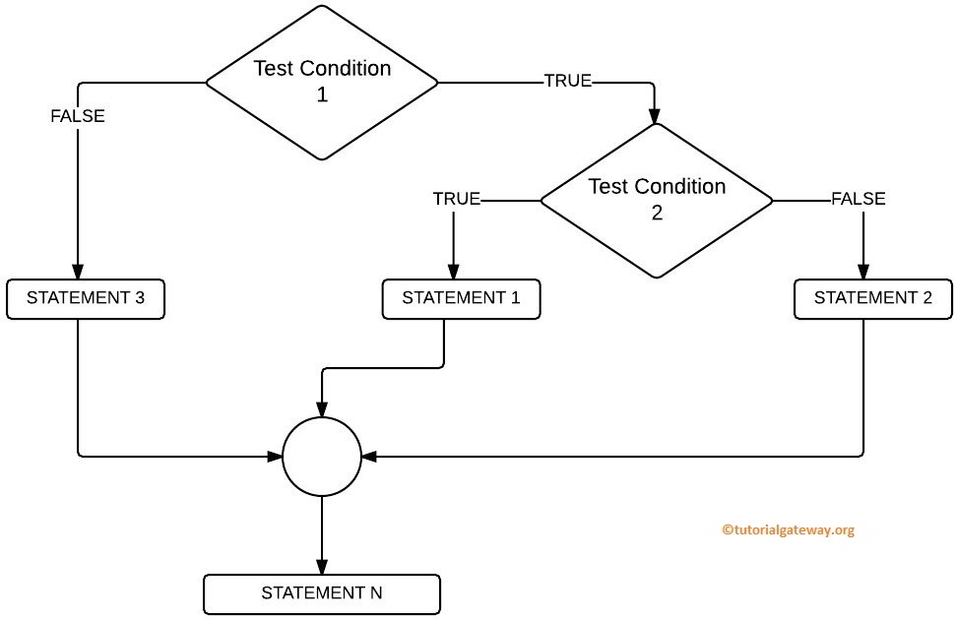
Flow Chart for Nested if in C Programming

Slide 16
Example: Test whether the given number is even or odd if it is below 100
#include <stdio.h> int main()
{ int n ; printf("Enter any integer number: ") ; scanf("%d", &n) ; if ( n < 100 ) { printf("Given number is below 100\n") ; if( n%2 == 0) printf("And it is EVEN") ; else printf("And it is ODD") ; } else printf("Given number is not below 100") ; return 0; }
Output 1 :
Enter any integer number : 55
Given number is below 100
And it is ODD
Output 2 :
Enter any integer number : 999
Given number is not below 100

Slide 17
else if Ladder Statement
This is the most general way of writing a multi-way decision.
Syntax:
if (condition1)
stmt1;
else if (condition2)
stmt2;
- - - - -
else if (condition n)
stmtn;
else
stmt x;

Slide 18
Explanation about syntax
First of all condition_expression_One is tested and if it is true then statement1 will be executed and control comes out out of whole if else ladder.
If condition_expression_One is false then only condition_expression_Two is tested. Control will keep on flowing downward, If none of the conditional expression is true.
The last else is the default block of code which will gets executed if none of the conditional expression is true.

Slide 19
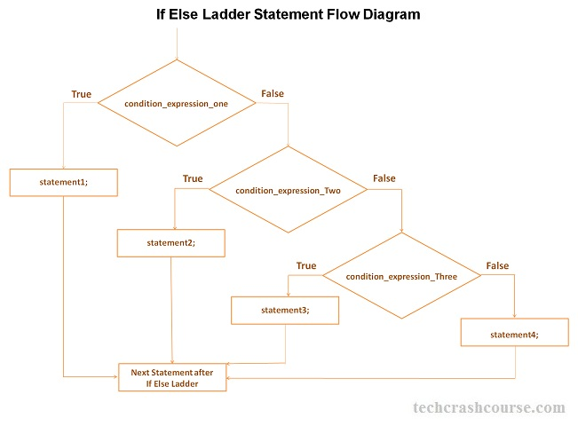

Slide 20
Example : Find largest of three numbers
#include <stdio.h> int main()
{ int a, b, c ; printf("Enter any three integer numbers: ") ; scanf("%d%d%d", &a, &b, &c) ; if( a>=b && a>=c) printf("%d is the largest number", a) ; else if (b>=a && b>=c) printf("%d is the largest number", b) ; else printf("%d is the largest number", c) ;
return 0; }
Output : Enter any three integer numbers: 55 60 20
60 is the largest number

